Slide 1

K-Means Cluster Analysis With NHANES Data Using A Shiny App
Duke Appiah

Slide 2
Outline
01
Background: objective and literature review
01
Methods: design of the app, source of data, data analysis
01
Results: App demonstration and data presentation.
01
Conclusions: strength and limitations

Slide 3
Background

Slide 4
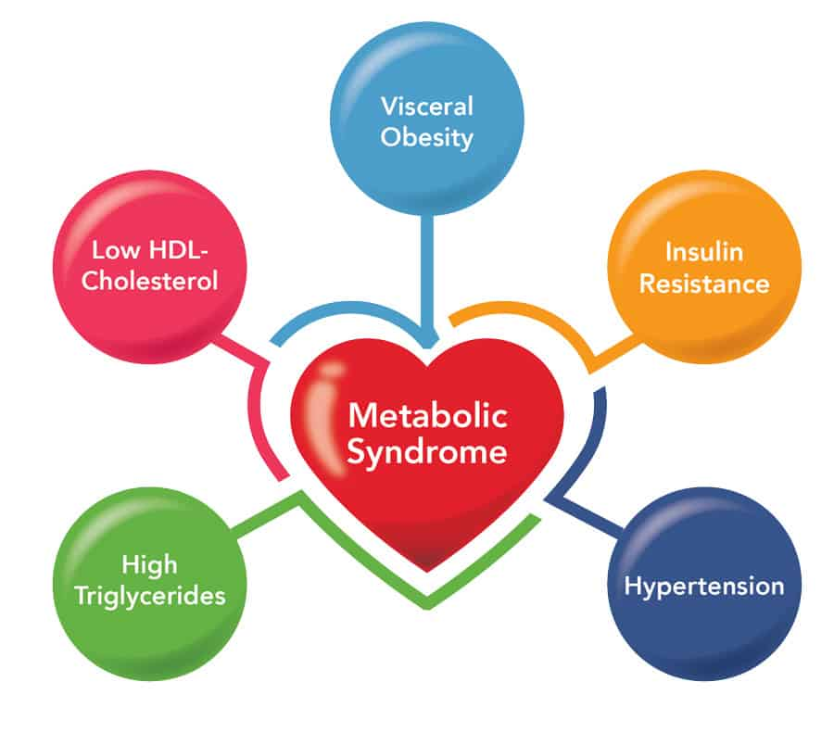
What Is Metabolic Syndrome
Metabolic syndrome (MetS) affects up to one-third of U.S. adults are reported to have this syndrome.
MetS is a complex condition encompassing several factors:
Low HDL cholesterol
Increased fasting glucose
Increased triglyceride
Elevated waist circumference
Elevated peripheral blood pressure

Slide 5
Effects Of Metabolic Syndrome
MetS increases the risk of multiple chronic diseases such as heart disease, stroke and type 2 diabetes.
The risk is higher for persons with more clusters of the components of MetS.
However, most of the disorders associated with MetS don't have obvious signs or symptoms.

Slide 6
Rationale For The Current Study
There is no publicly-available tool for easily identifying the various possible clusters within the various components of MetS in the United States.
Knowing these clusters of MetS will help in quantifying the burden of the various clusters and provide additional avenues for public health interventions.

Slide 7
Methods

Slide 8
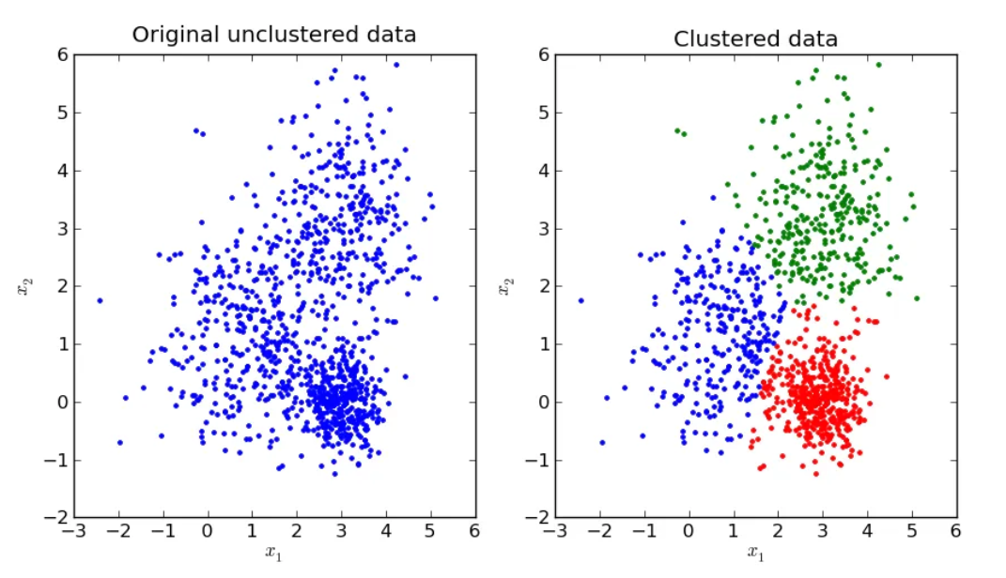

Designing the App
The App was developed using R shinny to perform K means clustering analysis
This is an algorithm that groups similar observations into groups called clusters.
The goal is a set of clusters, where each cluster is distinct from other clusters, and the observations within each cluster are broadly similar to each other.

Slide 9
Description of the App
1
2
3
There are six variables available (Age, BMI, systolic blood pressure, glycohemoglobin HDL and total cholesterol
The user has an option to select between 1 to 9 clusters
The App accepts inputs of two components of MetS at a time
4
5
A graph is provide that visually shows the clusters the user selected using different colors
Another graph is provided that guides the user on the optimal clusters to use based on the average silhouette width

Slide 10
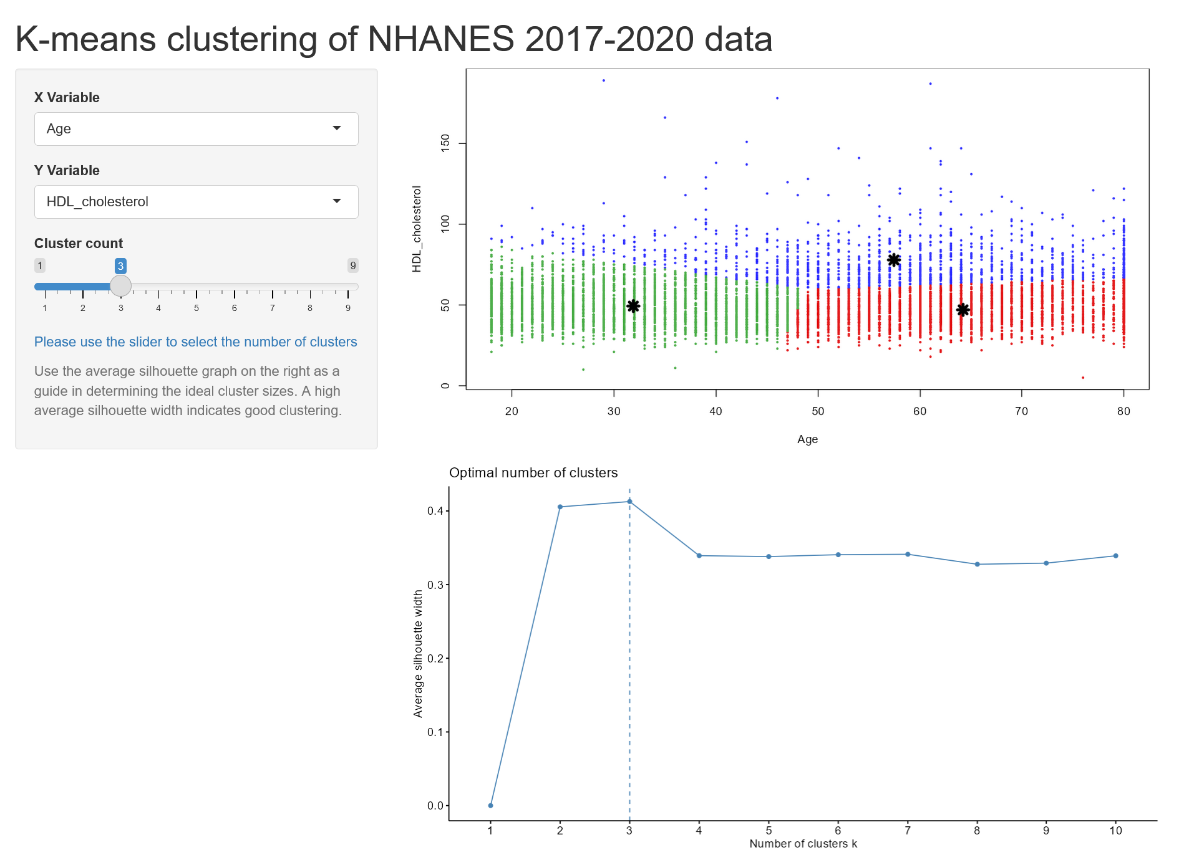
Description of the App
1
4
2
3
5

Slide 11
Description of the App
To run it locally, the user will need to install the latest versions of the following R packages
Shiny (http://shiny.rstudio.com)
Factoextra ( https://cran.r-project.org/web/packages/factoextra/index.html
The app and information related to it are available at GitHub (https://github.com/Dukeappiah1/k-means.git)

Slide 12
Source of Data For The App
Data were from the 2017-2020 cycle of the National Health and Nutrition Examination Survey (NHANES).
It is administered by the National Center for Health Statistics.
NHANES is an ongoing stratified, multistage, probability survey designed to assess the health and nutritional status of non-institutionalized adults and children in the United States (available at https://www.cdc.gov/nchs/nhanes/.
The survey is unique in that it combines interviews and physical examinations.

Slide 13
Source of Data For The App
Data on 7425 adults aged 18 years and older with complete data on
Age
Systolic blood pressure
Body mass index
Glycohemoglobin,
HDL cholesterol
Total cholesterol.
The analytic dataset as well as the code to create it are available at GitHub (https://github.com/Dukeappiah1/k-means.git)

Slide 14
Results

Slide 15
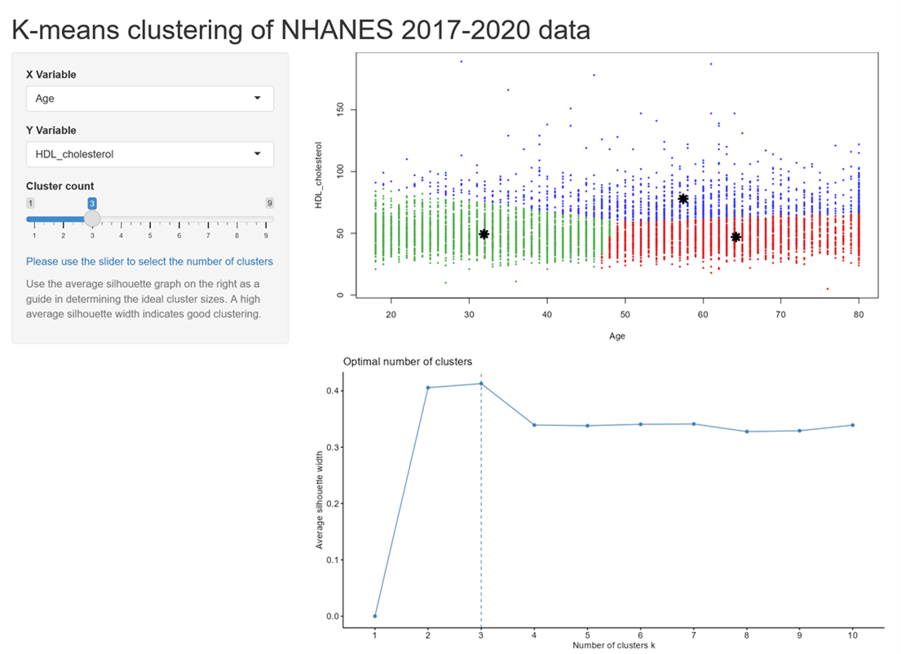
Demonstration of The Use of The App
This is how the homepage of the App looks

Slide 16
Demonstration of The Use of The App
The next few slides shows how the App can be used to select the number of optimal clusters when evaluating the relation of systolic blood pressure with high density lipoprotein(HDL) cholesterol.
The following slides will be a demonstration of:
How to select the variables
How to select the number of clusters
How the graphs changes with number of clusters
How to determine the optimal cluster size using the graph of the average silhouette width

Slide 17
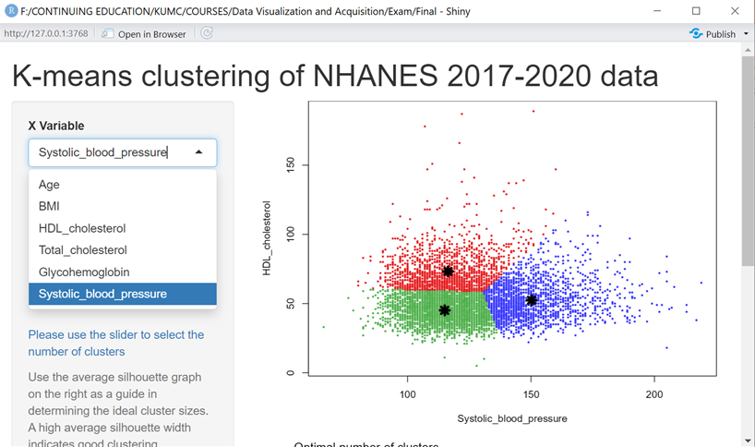
Demonstration of The Use of The App
The user selects the variable to be plotted on the x axis

Slide 18
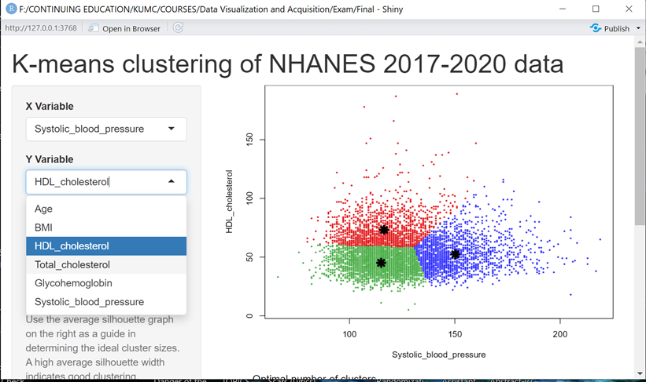
Demonstration of The Use of The App
The user selects the variable to be plotted on the y axis

Slide 19
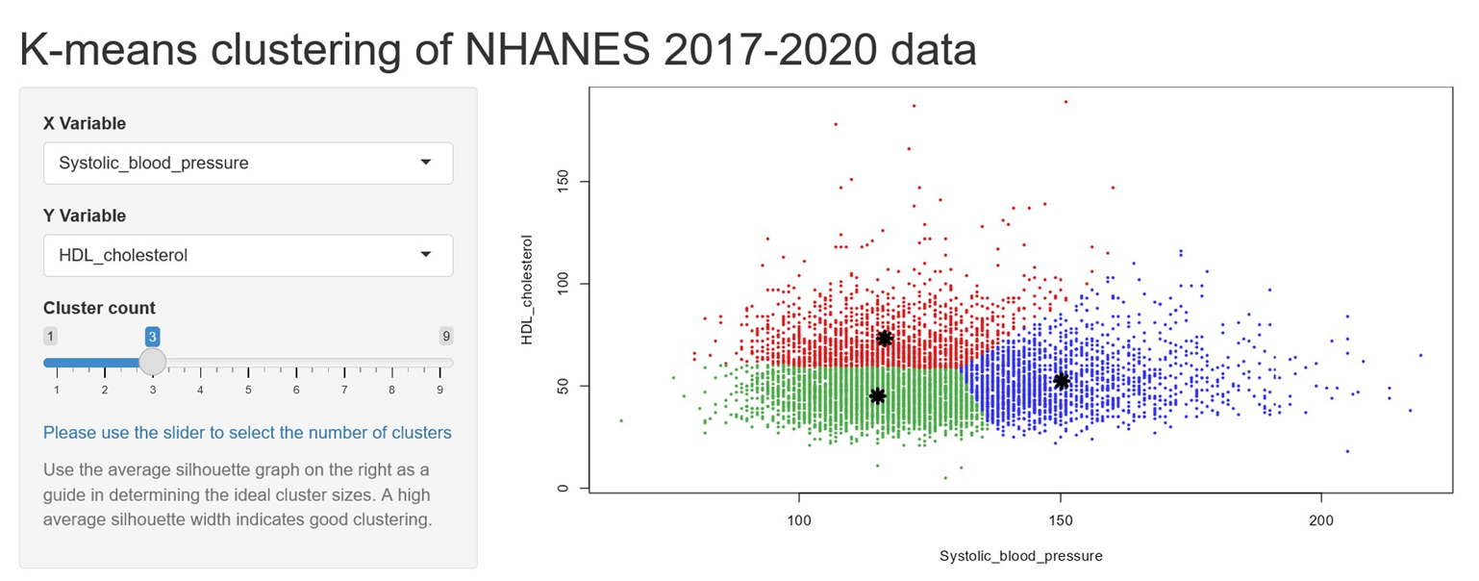
Demonstration of The Use of The App
The user selects the number of cluster. The default is 3

Slide 20
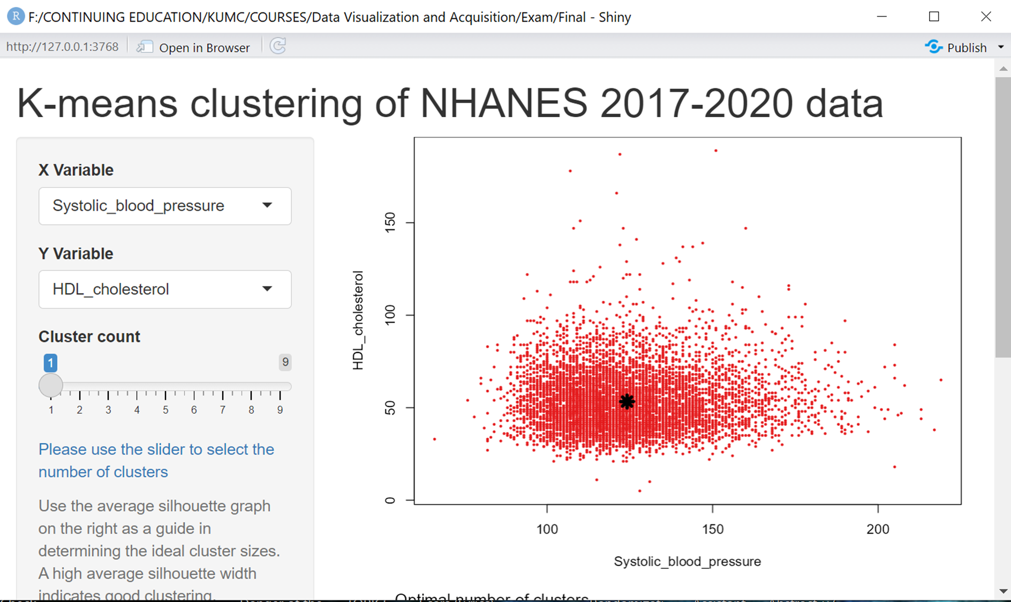
Demonstration of The Use of The App
This is how the graphs looks when the user selects 1 cluster

Slide 21
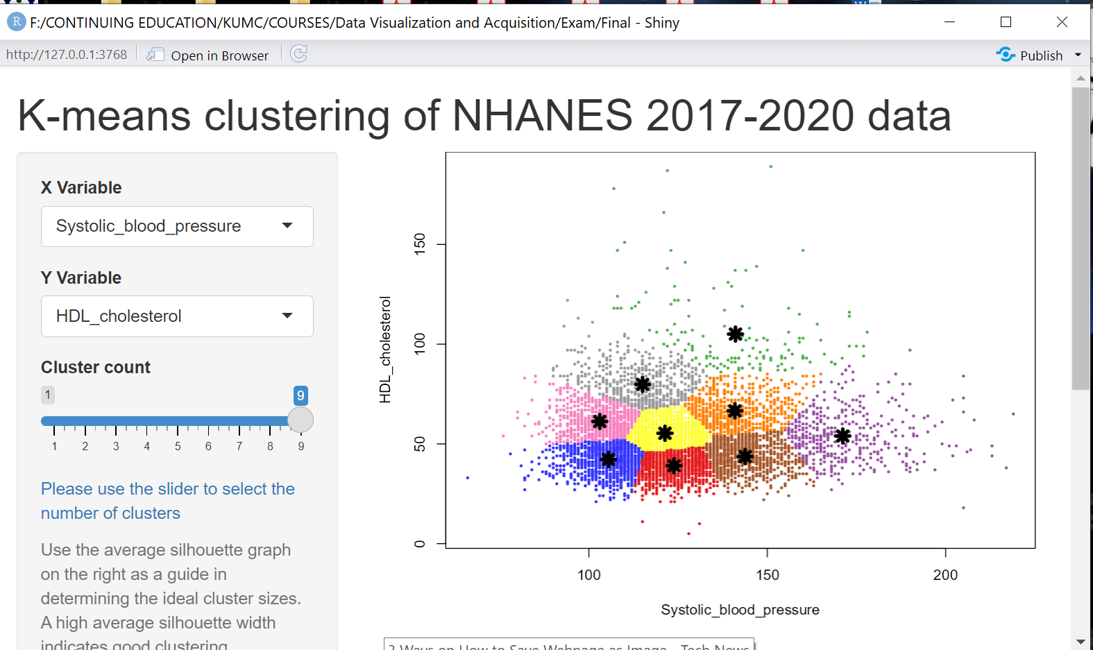
Demonstration of The Use of The App
This is how the graphs looks when the user selects 9 clusters

Slide 22

Demonstration of The Use of The App
This user goes back to select 3 clusters

Slide 23
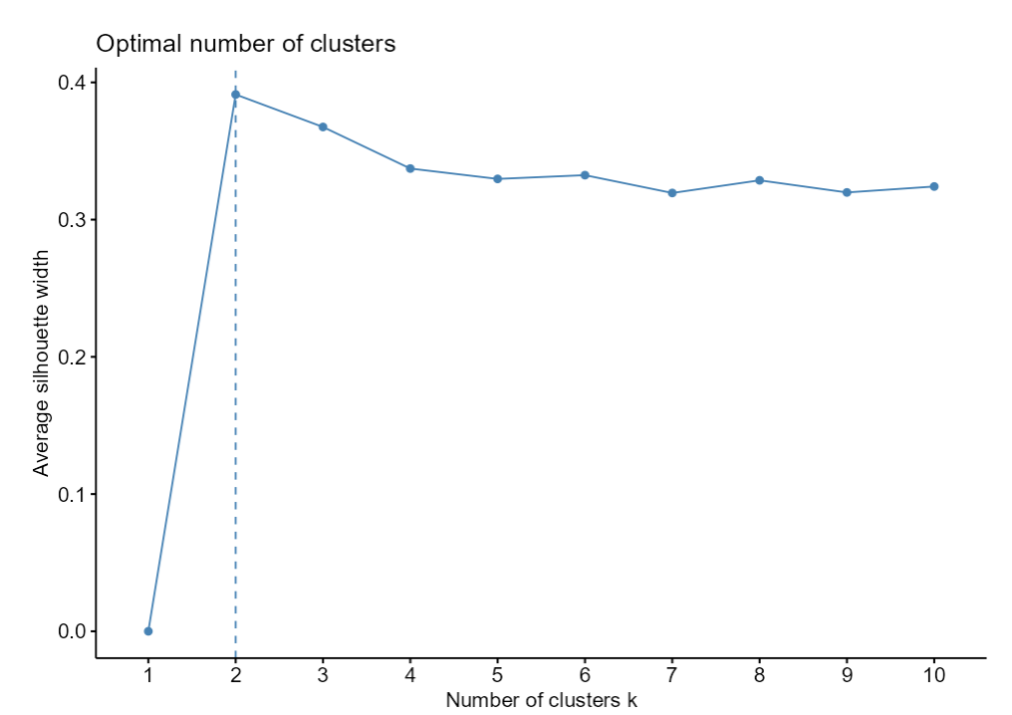
Demonstration of The Use of The App
The graph based on the silhouette width suggests two clusters may be ideal for the data

Slide 24
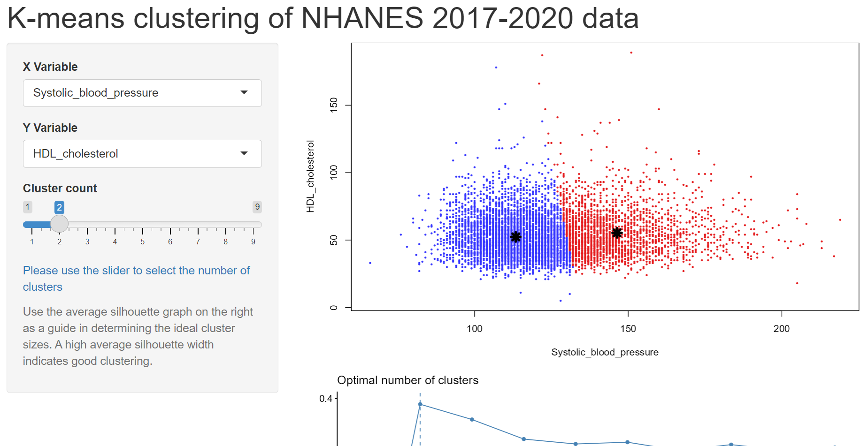
Demonstration of The Use of The App
So 2 clusters are selected

Slide 25
Summary of Findings
So when evaluating HDL cholesterol and systolic blood pressure, two distinct clusters are identified with clinical significance
Cluster 1: participants with systolic blood pressure less than 130 mmHg (considered as non- hypertensive) and having HDL levels between 50 to 100 mg/dl
Cluster 2: participants with systolic blood pressure ≥130 mmHg (considered having hypertension) and having HDL levels between 50 to 100 mg/dl

Slide 26
Conclusions

Slide 27
Strengths
A user-friendly app for estimating clusters using unsupervised learning methods (Kmeans)
It also provides guidance to the user with regard to the selection of optimal clusters based on the average silhouette width
The app is implemented on the most recent nationally-representative sample of American adults aged 18 years and older who participated in NHANES

Slide 28
Limitations
Future developments needs to consider providing prevalence estimates for the various clusters estimated.
Addition of more methods for selecting the optimal number of clusters

Slide 29
Acknowledgment
Some of the code used to create this app are based on the Kmeans example from the Shiny gallery available at https://shiny.posit.co/r/gallery/start-simple/kmeans-example/

Slide 30
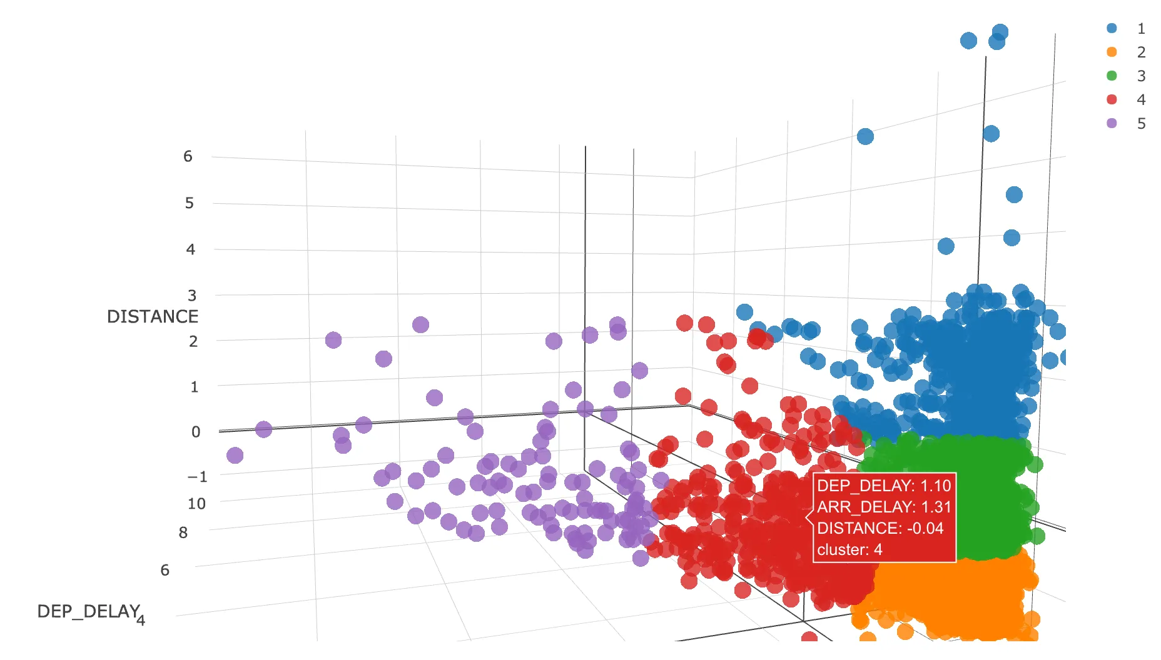
Thanks!
Any questions?
Please contact:
Duke Appiah:
dappiah@kumc.edu

